Slide 1

MENTORA Mentorship Simplified, Growth Amplified
HACKATHON PROJECT

Slide 2
TEAM MEMBERS
ARBAB HUSSAIN
Team Lead, Web Developer
Farooque Sajjad
Front End Developer
Talha Arain
Backend Developer
Rafy Mustafa
Ux Designer

Slide 3

Problem Statement
THE MENTORSHIP GAP IN PAKISTAN
1
Lack of Guidance for Young Students
(Ages 16-18)
2
Limited Access to Experts, making
mentorship Inaccessible
3
No Such Centralized Mentorship Platform

Slide 4
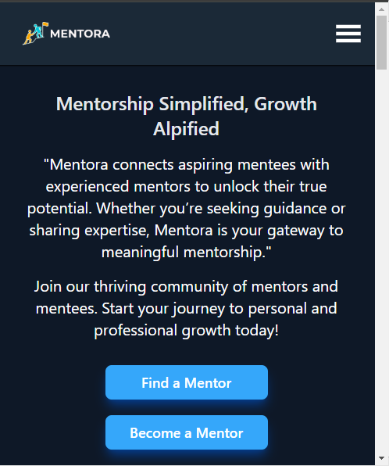
SOLUTION
MENTORA
Mentorship Hub
One on One Personalised Sessions
Seamless Meeting Scheduling
Notes:
Better Career Decisions – First-hand guidance from professionals.
📈 Increased Opportunities – Exposure to new careers, scholarships, and internships.
💡 Confidence Boost – More prepared and motivated students.
🔗 Bridging the Knowledge Gap – Connecting ambition with experience.

Slide 5





CORE FEATURES OF MENTORA
1
Register
2
Find Mentor
3
Schedule Sessions
4
Join Meetings
5
Give Reviews

Slide 6




TECHNOLOGIES USED
REACT JS
MONGO DB
FRONT END
DATABASE
NODE AND EXPRESS JS
BACK END

Slide 7
PROJECT TIMELINE
Idea Selection
Designing
Final Touches and Testing
23-Dec-24
15-Jan-25
30-Jan-25
Requirements Gathering and Analysis
Development
Submission
17-Jan-25 to 29-Jan- 25
31-Jan-25
25-Dec-24

Slide 8



FUTURE UPDATES
In App Video and Audio Calls
Currently, the platform doesn’t support audio and video calls, instead, users must use any third-party app for meetings like zoom, google meet etc.
Modern Ui
Mobile App
We would be making the interface modern, minimal and intuitive
Launching a cross-platform mobile app for much more ease and better accessibility.

Slide 9
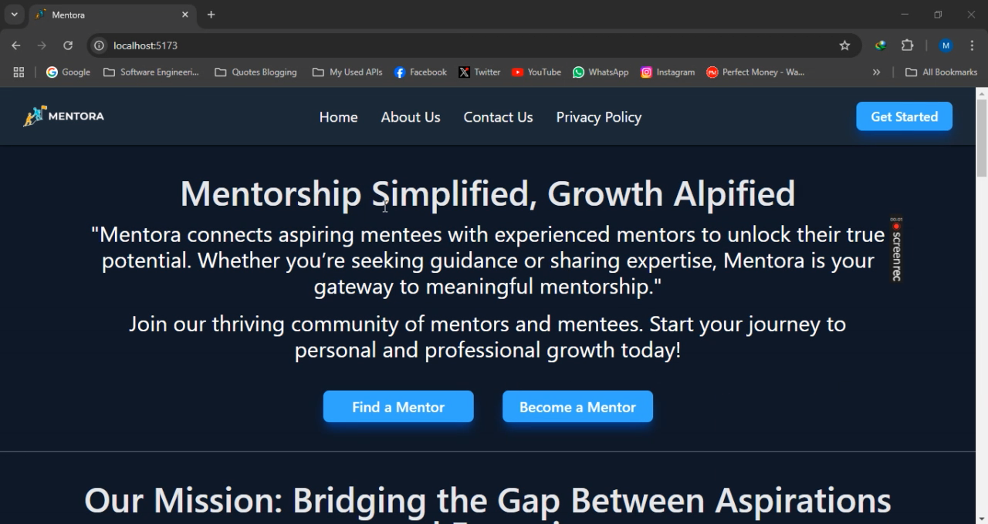
Demo of Mentora

Slide 10
THANK YOU!
Let’s Make Mentorship Easy and Accessible with MENTORA

